Slide 1
Natural language processing (NLP)
By: Aditya Agrawal
Jatin Kumar
Satyam sHivankur
Vikash

Slide 2
Outline
Basics of NLP
Text Pre-processing & Vectorization
Steps to build Language detection model using NLP
Questions & Answers

Slide 3
What is NLP?
NLP (Natural Language Processing) is analysis or generation of natural language text using computers.
For Example:
Language Detection
Machine Translation
Next Word Prediction
Automated query answering
Speech Parsing

Slide 4
What is NLP Based on?
NLP is primarily based on
Probability and Statistics
Machine Learning/Deep Learning
Linguistics
Common sense

Slide 5
Why NLP?
Language is one of the defining characteristics of our species
NLP helps to resolve ambiguity in language and adds useful numeric structure to the data
A large corpus of knowledge can be organized and easily accessed using NLP

Slide 6
Types of use-cases in NLP
Text Classification
Named Entity Recognition
Text Parsing
Text Synthesis
Reasoning

Slide 7
Text Pre-Processing
Tokenization
Stop words Removal
Lower case conversion
Removing numeric/digits
Removing Punctuations/Special Characters
Removing characters (for foreign languages)
Normalization
Stemming & Lemmatization

Slide 8
Vectorization
Bag-of-Words (Count Vectorizer)
Bag of Words converts text into set of vectors containing the count of word occurrences in the document.
▪
TF-IDF
TF-IDF creates vectors from text which contains information on the more important words and the less important ones as well
Word2Vec
Word2vec creates vectors that are numerical representations of word features, features such as the context of individual words. The purpose and usefulness of Word2vec is to group the vectors of similar words together in vector space. That is, it detects similarities mathematically.

Slide 9
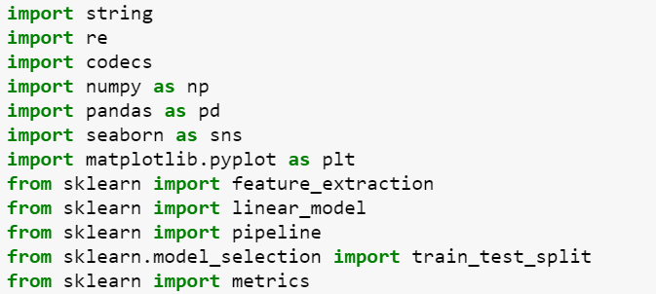
Build Language Detection Model
Importing Libraries:

Slide 10
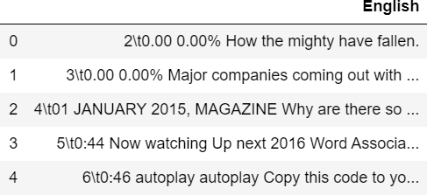
Build Language Detection Model
Loading English Raw Data:

Slide 11
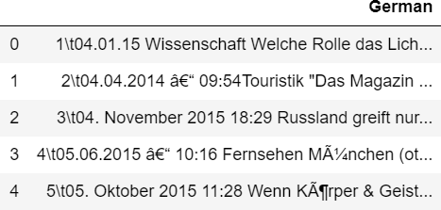
Build Language Detection Model
Loading German Raw Data:

Slide 12
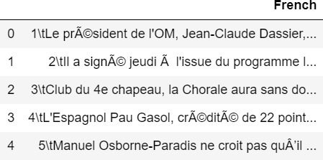
Build Language Detection Model
Loading French Raw Data:

Slide 13
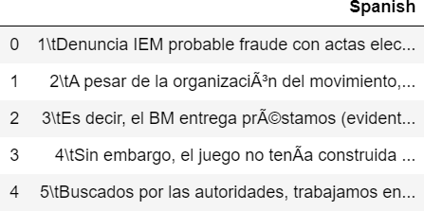
Build Language Detection Model
Loading Spanish Raw Data:

Slide 14
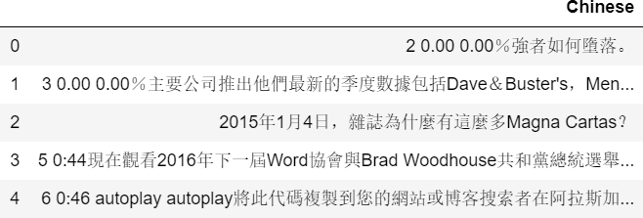
Build Language Detection Model
Loading Chinese Raw Data:

Slide 15

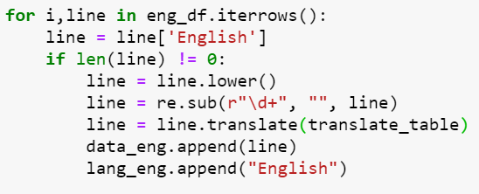
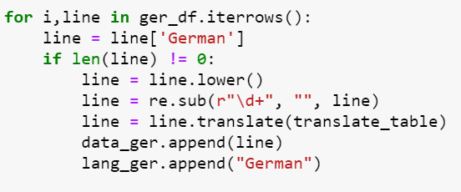
Build Language Detection Model
Data Pre-Processing

Slide 16
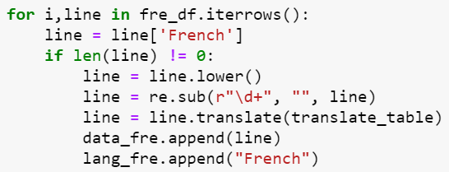

Build Language Detection Model
Data Pre-Processing

Slide 17
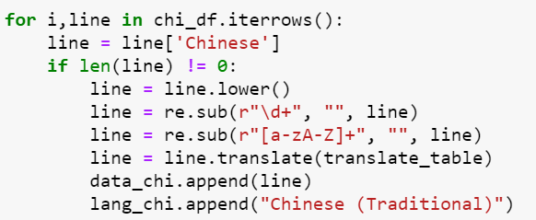
Build Language Detection Model
Data Pre-Processing

Slide 18

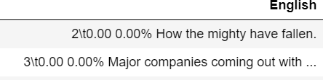
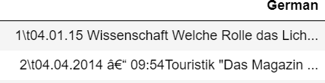
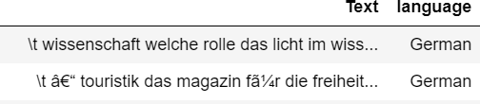
Build Language Detection Model
Data Before and After Pre-Processing

Slide 19


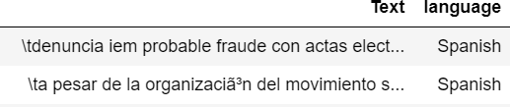
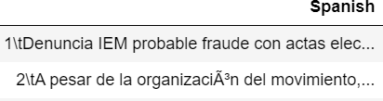


Build Language Detection Model
Data Before and After Pre-Processing

Slide 20
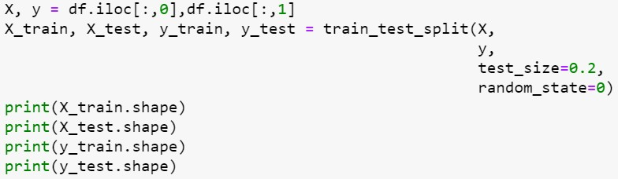

Build Language Detection Model
Splitting Data into Train and Test sets (80:20)

Slide 21
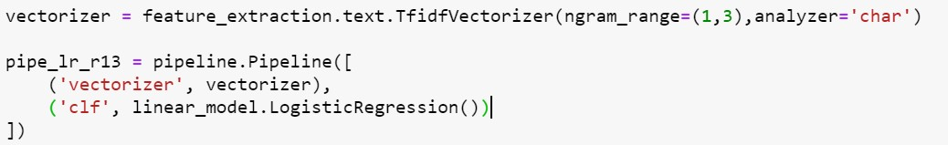
Build Language Detection Model
Vectorizer and Model fitting Pipeline
Model Fitting

Slide 22
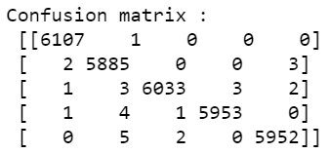
Build Language Detection Model
Model Prediction
Model Evaluation

Slide 23
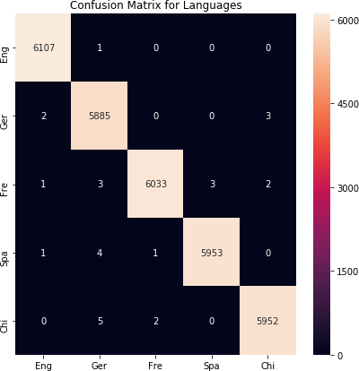
Build Language Detection Model
Confusion Matrix

Slide 24
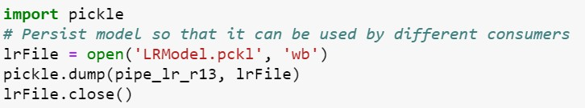
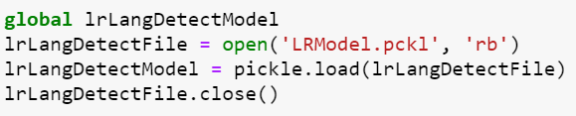
Build Language Detection Model
Model Saving
Model Loading

Slide 25
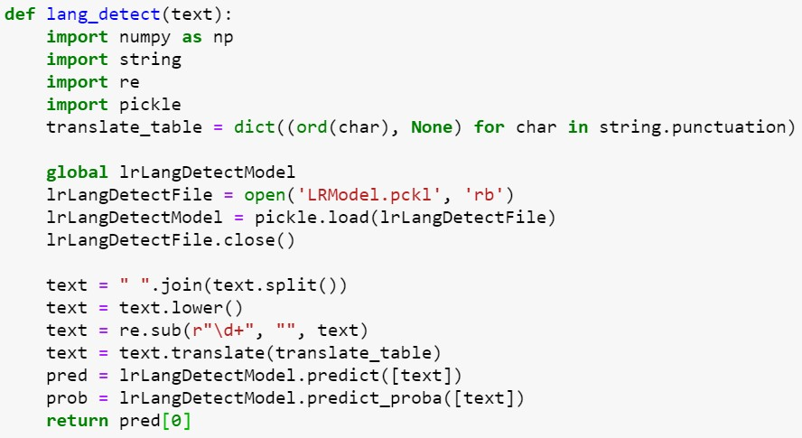
Build Language Detection Model
Method Definition to call Trained Model and Make Predictions

Slide 26

Build Language Detection Model
Predictions

Slide 27
Thank You

